Slide 1
Global Office 365 Bootcamp – Madrid, Spain
Luis Mañez
Office Development MVP - ClearPeople

Slide 2
Agenda
Time | Topic / Activity | Speaker
XX am | Insert Topic here | Name of Speaker here

Slide 3
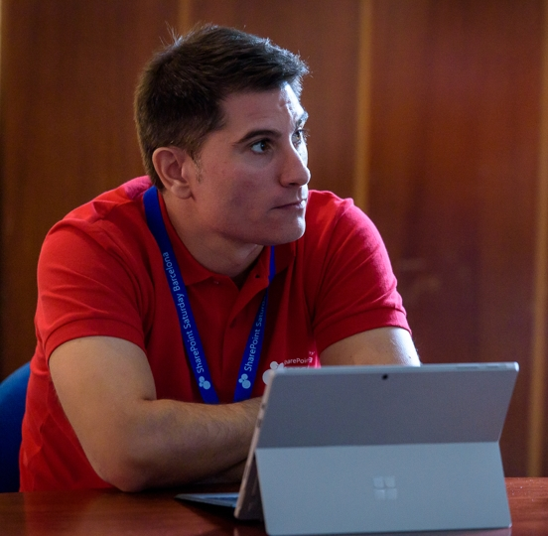

Luis Máñez
SharePoint and Cloud solutions architect en ClearPeople.
Office Development MVP. Cerca de 15 años trabajando con tecnologías Microsoft. SharePoint MCPD y Certified specialist in Developing Azure. OfficeDev PnP Key contributor.
https://twitter.com/luismanez
https://github.com/luismanez
https://medium.com/inherits-cloud
https://www.linkedin.com/in/luismanez/

Slide 4

Enjoy the Bootcamp

Slide 5
BE
MODERN

Slide 6



Technology mapping Classic vs Modern
FX

Slide 7
Microsoft Cognitive Services

Slide 8
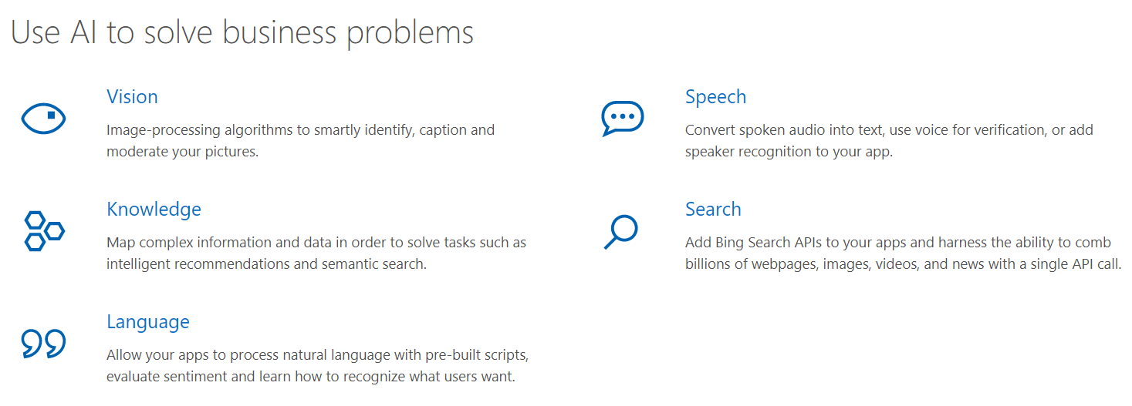
https://azure.microsoft.com/en-us/services/cognitive-services/?v=17.42n

Slide 9
Spfx Extensions

Slide 10

Call to action
(Recommendation to Bootcamp organizers and speakers: This slide can be used at the end of the Bootcamp to have attendees to fill online feedback form and recommendation for their ongoing learning and app development on Office 365 platform. Please keep the first three bullet points, you can update the last bullet point to be the user group or community that you are leading that you’d like attendees to join and learn more. Please keep the first feedback bullet point at the top and feel free to re-arrange the rest of bullet point orders. Thanks.
Share your feedback on Bootcamp at https://aka.ms/o365devbootcampfeedback
Join Office 365 developer program https://dev.office.com/devprogram to leverage all resources for Office 365 development learning
Build applications on Office 365 platform
Attend MVP led local community events to continue learning on Office 365 development

